Slide 1
Multi-Image Based Photon Tracing for Interactive Global Illumination of Dynamic Scenes
Chunhui Yao¹ Bin Wang¹ Bin Chan²
Junhai Yong¹ Jean-Claude Paul^{3,1}
¹ Tsinghua University, China
² The University of Hong Kong, China
³ INRIA, France
Notes:
Good afternoon. Today I’m glad to give a talk about how to use multiple images for photon tracing so that we can get interactive global illumination in dynamic scenes.

Slide 2
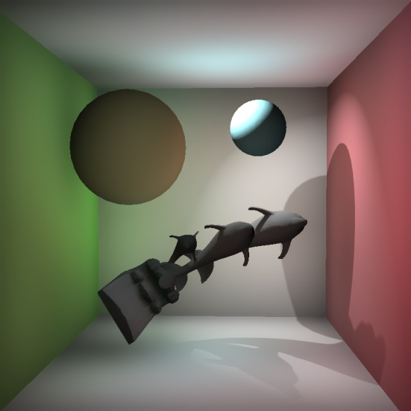
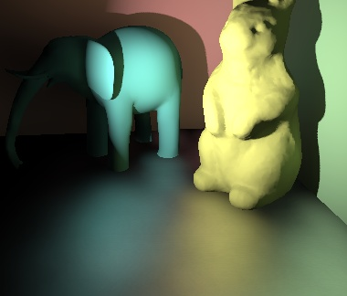
Motivation
A Simple, Practical Technique for
Interactive
Global Illumination
of Dynamic Scenes
Multi-bounces on both low and high frequency surfaces with occlusion
Fast enough to response user’s actions immediately
No pre-computation, everything (camera, light, geometry) completely dynamic
Easy to implement on conventional hardware
specular
glossy
diffuse
Notes:
The goal is high quality global illumination of all frequency reflections from diffuse inter-reflection to caustics with multiple bounces of indirect lightings and occlusions, which is produced interactively. We also hope that there are no pre-computations so that all elements are completely dynamic. At last, and maybe the most important, the technique should simple and practical enough, and easy to implement on conventional hardware.

Slide 3
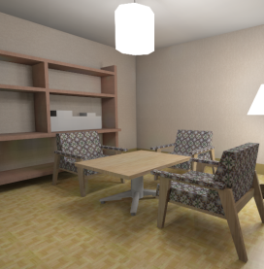
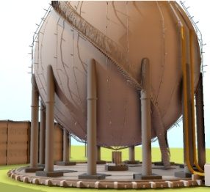
Previous Work
Interactive GI for dynamic scenes
VPL, Instant Radiosity
[Keller 97]
Low frequency reflection
Visibility is expensive
SSAO,SSDO
Simple and fast
Approximate, not physics based
Photon mapping
Handle all frequency with visibility
Require spatial index structure
Pre-computed on CPU [McGuire 09], or
Complicated implementation on GPU [Wang 09]
Notes:
Interactive global illumination of dynamic scenes is a very popular topic these years.
Most previous techniques are based on virtual point lights or instant radiosity for low frequency indirect illumination. The visibility testing is the most expensive part of these techniques. Many of them approximate visibility or simply neglect indirect occlusions.
The screen space approaches for ambient occlusion or directional occlusion are very simple and fast, but only produce quite approximated unphysical results.
Photon mapping handles all frequency reflections physically and visibility is naturally included. However, existing interactive photon mapping methods requires complex spatial index structure, such as a KD-tree for photon tracing. This structure is either pre-computed on CPU or build on GPU with complicated implementation.

Slide 4
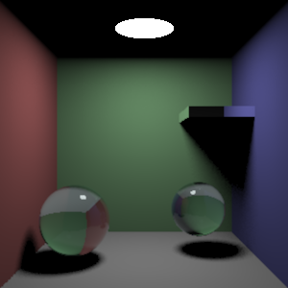
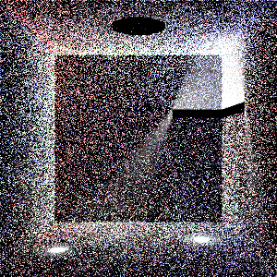
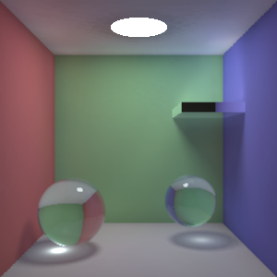
Photon Mapping
Traditional photon mapping
Off-line rendering
Seconds / minutes for rendering
Two stages
Photon tracing
Radiance reconstruction
We focus on this
Photon splatting on GPU
[Sturzlinger 97] [Lavignotte 03] [Herzog 07] [McGuire 09]
Notes:
Now let’s recall how photon mapping works.
Photons are emitted from light sources and traced throughout the scene. This photon distribution is obtained by recording all photon hit points in photon map. Then radiance was reconstructed with the help of photon distribution.
Traditional photon mapping require long time to render one frame because these two stages are both time consuming.
Many earlier works explored to use the splatting method on GPU for construct radiance in real-time. Therefore this paper mainly focus on the former step, that is, how to use GPU for efficient and practical photon tracing.

Slide 5
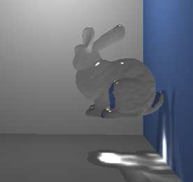
Previous Works
Image space photon tracing
Caustic mapping
[Wyman 06] [Hu 07] [Shah 07] [Wyman 08]
Use single image for specular reflections
Caustic photon rays
Easy to be predicted
Contain in a single image
Global photon rays
More complex
May start and arrive at any position of the scene
Notes:
Instead of using complex spatial structures, we adopt a simple image space approach for photon tracing. This idea has already been introduced in some earlier works. However all of them only take account of specular reflections, because the caustic photon ray can be easily predicted and contained in a single image. But this is no longer applicable for the more complex global photon mapping, because global photon rays may start and arrive at any position of the scene.

Slide 6
Image Space Photon Tracing
 |  | Image Space | Object Space
Pros. | Building representation | Fast | Slow
 | Implementation | Simple | Complicated
 | Searching time | Constant | Depend on geometry complexity
Cons. | Accuracy | Approximate | Accurate
 | Applicability | Limited | All cases
Notes:
Now look at the comparison between image-space photon tracing and that in the object-space.
The yellow lines are the pros.
Building an image representation is much faster than building a KD-tree for the scene and the implementations for image space methods are usually simpler. Additionally, the time for searching intersection in image space is independent of the complexity of geometry.
But the shortcomings of image space methods are also apparent.
First, the results of intersection test are not accurate for they are obtained from the pixels.
Second, because the scene must *can* be sampled by images, the application usually restricted to the simple scenes.

Slide 7
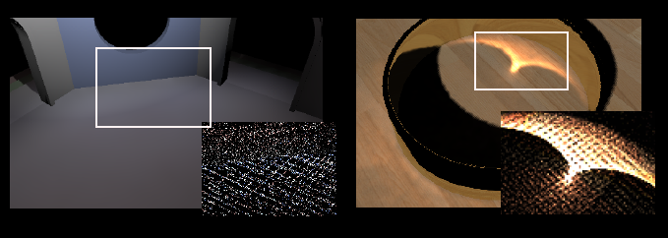
Why Image Space?
Consider the disadvantages
Approximate result
Photon mapping only care about the density of points
Represent geometry by images
Use multiple environment maps
Select centers to cover most surfaces
Our main contribution
Notes:
Then why here we choose image space method?
Let’s consider the mentioned disadvantages in context of photon tracing.
Because in photon mapping, the final illumination is computed according to the density of photon points but not the position itself, the approximate photon distribution will not cause visible artifacts in the final result. See these images.
The second problem is how to represent the geometry by images. The solution here is just the main contribution of our paper. We use multiple environment maps to sample the scene and the centers are selected to cover most surfaces.

Slide 8
Existing Methods
Image space ray tracing
For specular reflection
[Szirmay-Kalos et al. 2005]
For caustic photon tracing.
Caustic mapping
Basic idea
Store geometry information in depth maps
Implicit equation of the surface
Points along the ray
Solve equation
Notes:
There several methods for intersection estimation in images-space for specular reflections.
I’m not going to describe the details of their methods here. The basic idea is store geometry information in depth maps, and this depth map can be seen as implicit equation of the surface. To find intersection, solve the equation of the surface and the ray. The root can the found by iterations.

Slide 9
Problems with Single Image
Problem 1：Required point is not stored in the rendered image
Viewpoint
Ray
B
A
Notes:
However, simply using a single image to find intersection, as previous methods, has notable problems.
One problem is that the require point may not stored in the image. As in the example, the ray intersects the geometry with point A,
But point A can not be seen from the viewpoint because of the occlusion, so it is not encoded in the image. Of course the method can not find A, instead, a nearest visible point B will be returned.

Slide 10
Problems with Single Image
Problem 1：Uncovered area will always be dark
Illumination
Photons
Notes:
This problem means that the uncovered area will never receive any photons, so it is totally dark all the time.
The yellow point in the left figure indicates the center of the single image

Slide 11
Problems with Single Image
Problem 2: obtained result may be not the first intersection along the ray
Viewpoint
Ray
A
B
Notes:
Another problem, the obtained intersection may be not the first one along the ray.
Look at this example, the ray has two intersection with the scene, but only A is the correct, first intersection.
But it is possible to find point B, and you will never know it is not the first intersection.

Slide 12
Problems with Single Image
Problem 2: Light leaking
Illumination
Photons
Notes:
This problem will cause the light leaking as if there are no occlusions.

Slide 13
Multiple Environment Maps
Single environment map
Add more environment maps
Scene
Notes:
To overcome these problems, we use multiple environment maps for sampling the scenes.
A single environment map, clearly it can’t cover the whole scene.
So more maps centered at different positions are appended, so that most surfaces are covered.

Slide 14
How to Select Images?
Simplest idea
Choose them randomly
Coverage not guaranteed
Our idea
First sample large number of points randomly
Then choose some for largest coverage
This is a NP-hard problem
Equivalent to set-covering problem
Find smallest k sets covering all elements
Classical NP-hard problem
Notes:
One important problem is where are the centers of these environment maps.
The simplest idea is choose some random points, and pray for good coverage. But this is guaranteed all the time.
Our idea is to first sample a lot of random points, then choose a subset from them for the largest coverage.
But unfortunately this problem is just equivalent to the classical, NP-hard, set-covering problem.
So we can’t find an efficient and accurate solution.

Slide 15
Heuristic Selection
Selecting k points with greedy algorithm
Mark all points unselected
For all unselected points, compute its new coverage area
The area covered by the point but not covered by any selected point
Mark the point v with maximum new coverage area selected
Repeat for k times

Slide 16
New Coverage Area
selected
unselected
selected
New coverage area
Shadow
Notes:
Then how to compute the new coverage area for an unselected point?
This area can not be seen by any selected points. If we place a point light at each selected point, the require area will lie within the common shadow region.
And in fact the new coverage area is just the shadow area visible by the current candidate point.

Slide 17
Computing Area
Shadow generated by shadow mapping
Env. map from current point
Compute the area
In image space
Sum up areas of all shadowed pixels
Low resolution for performance
32x32x6
Only used for comparison
Notes:
From that observation, what we want is just the shadows in the environment map from the current point. Shadows can be generated by shadow mapping method. The area can be computed in image-space by summing up the area of all pixels in shadows.
Please recall that the purpose is find point with the largest area, the results are just used for comparison, so the value of area is not necessary to be accurate. The resolution of image for computing shadows can be very low for better performance.

Slide 18
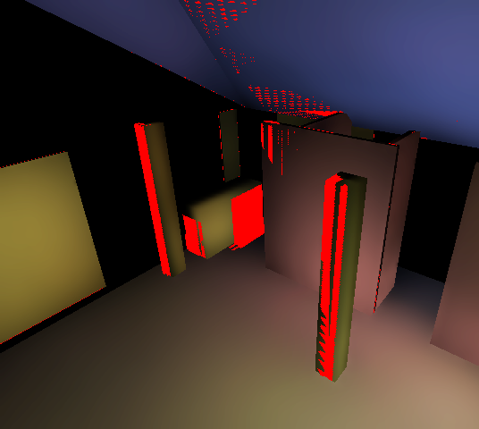
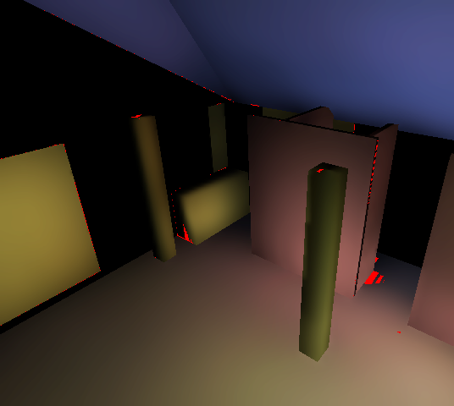
Coverage
Red pixels indicate uncovered area
8 random maps
8 selected from 27 random maps

Slide 19
Finding Intersection
Test with each environment map
Several results
Four possible types
Not in the ray
Infinity
A
Ray
No intersection
B
D
C
The correct intersection
Not first intersection
Notes:
Now we have a number of environment maps, so a photon ray can be tested with each of them. Therefore several results will returned.
Our new task is to find the most proper intersection as the final result.
We begin by classifying these results into for types.
A
B
C
D

Slide 20
Finding Intersection
Reject A immediately
Reject B by angle bias
Find the nearest point to the ray origin
Implemented as depth testing of rasterization
Infinity
A
Ray
B
D
C
Notes:
After that, the points of type A can be rejected immediately. Then the angle bias is computed for every intersection, only the ones with small bias are kept to reject type B so that the remaining are the points along the ray. The distances to the ray origin are compared to find the first intersection. This is implemented as the depth testing of rasterization hardware.

Slide 21
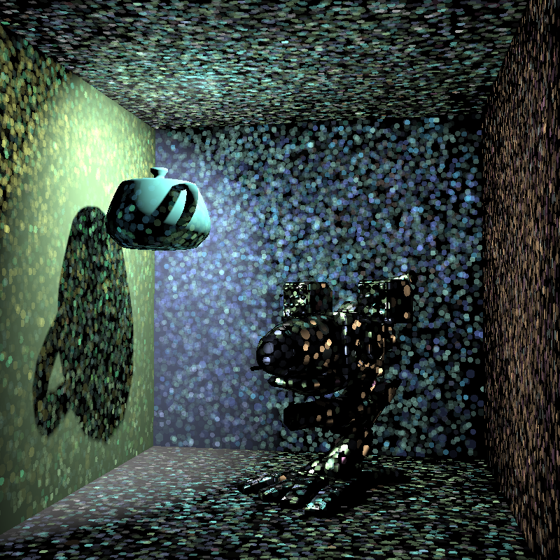
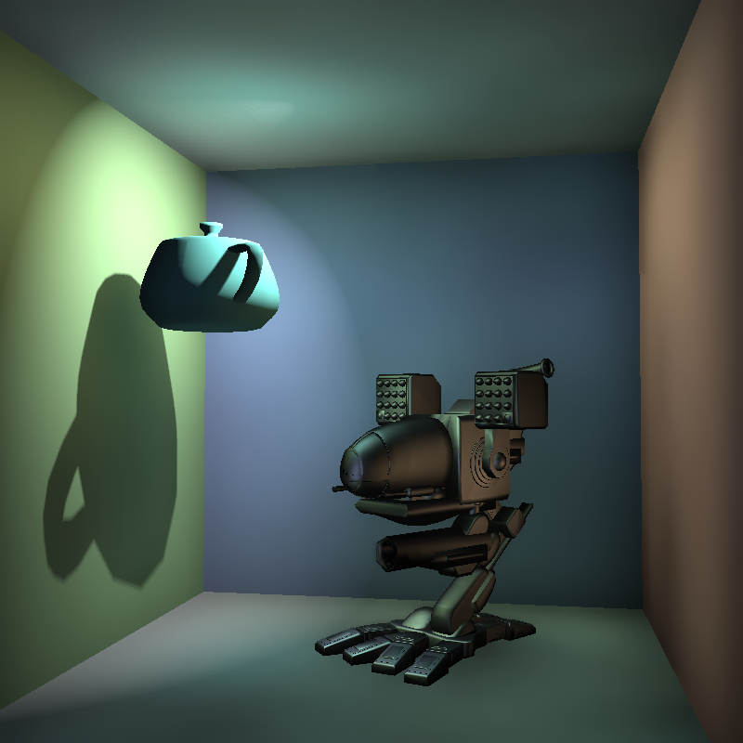
Rendering
Scatter illumination onto screen
Photon splatting
Notes:
After obtained the photon distribution, photon splatting method is adopted.

Slide 22
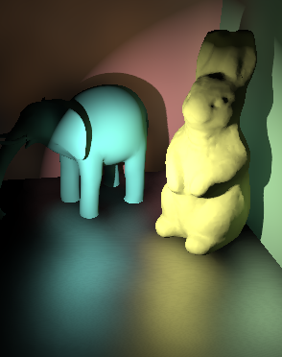
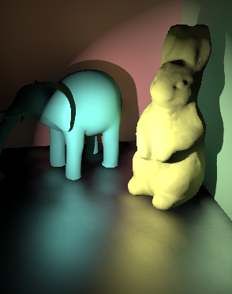
Variable splat sizes
Control by probability for variable splat sizes
Fixed splat sizes
Variable splat sizes

Slide 23
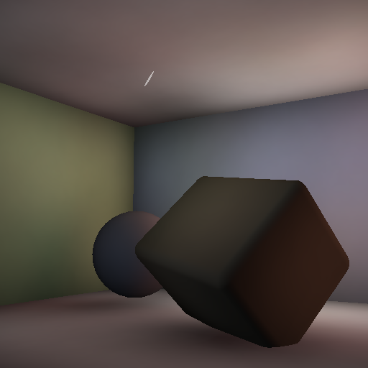
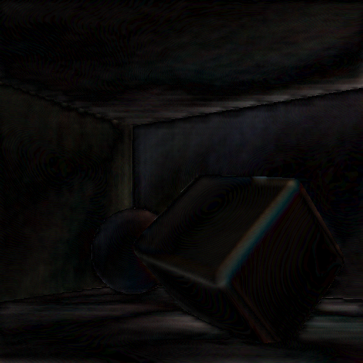
Multi-Level Upsampling
Reduce fill-rate
No upsampling 3FPS
3-level upsampling 24 FPS
8 x Error

Slide 24
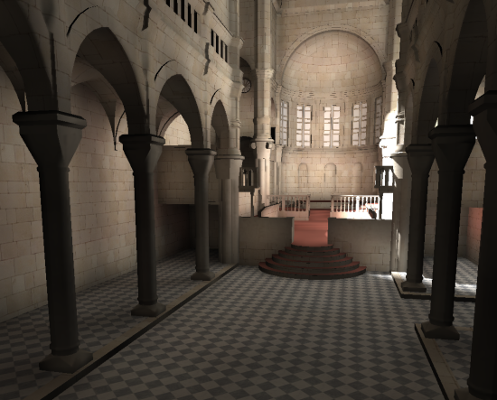
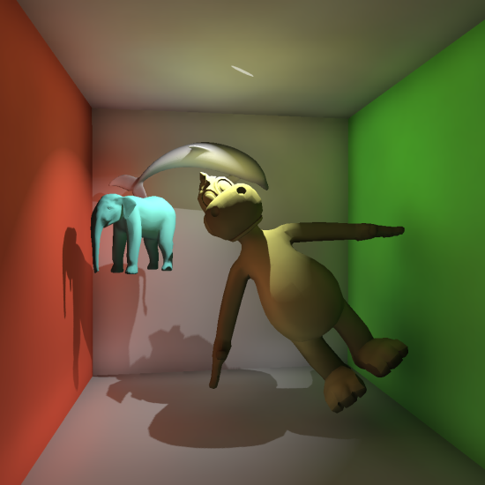
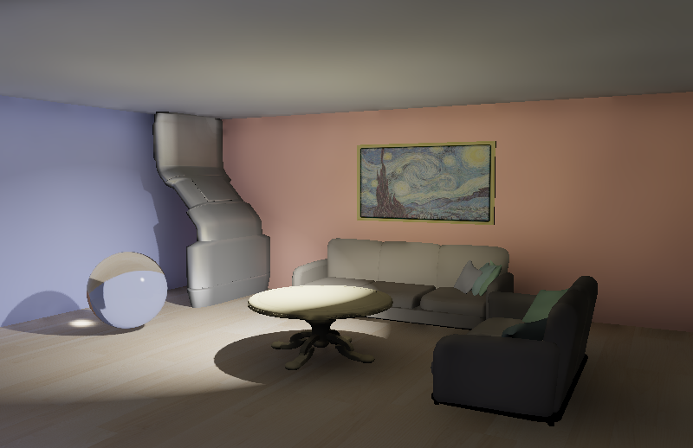
Result

Slide 25
Result: Glossy
Diffuse
Phong, n=30
Phong, n=100

Slide 26
Result: Caustics

Slide 27
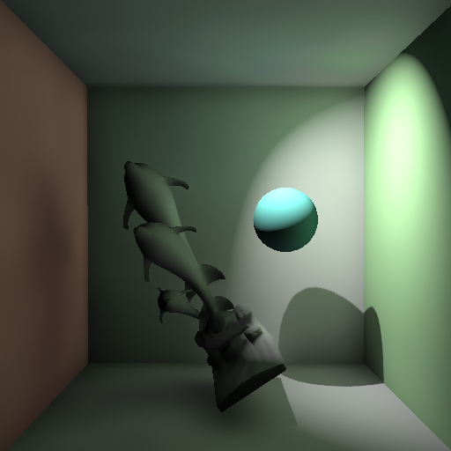
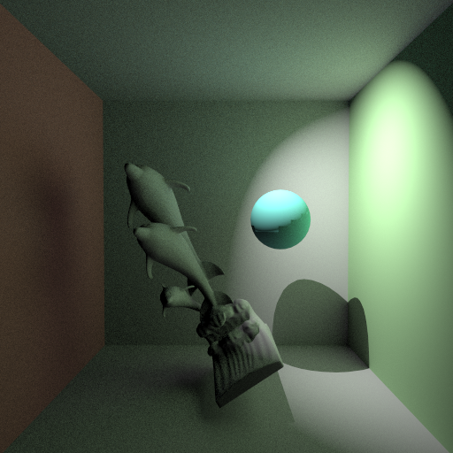
Ground Truth Comparison
Both 512 x 512
Ours: 47 ms
Path tracing: 48min
Indirect shadows

Slide 28
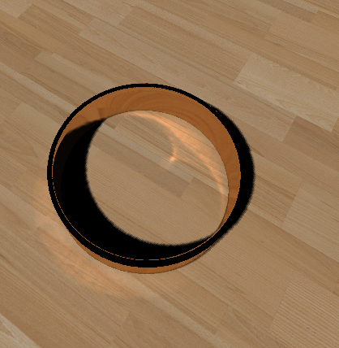
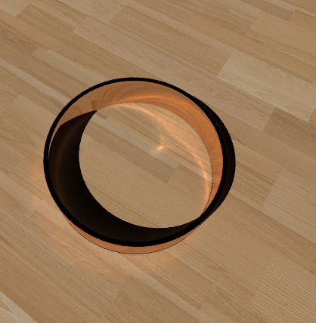
Ground Truth Comparison
Both 512 x 512
Ours: 26 ms
Photon Mapping: 5 min
Caustics

Slide 29
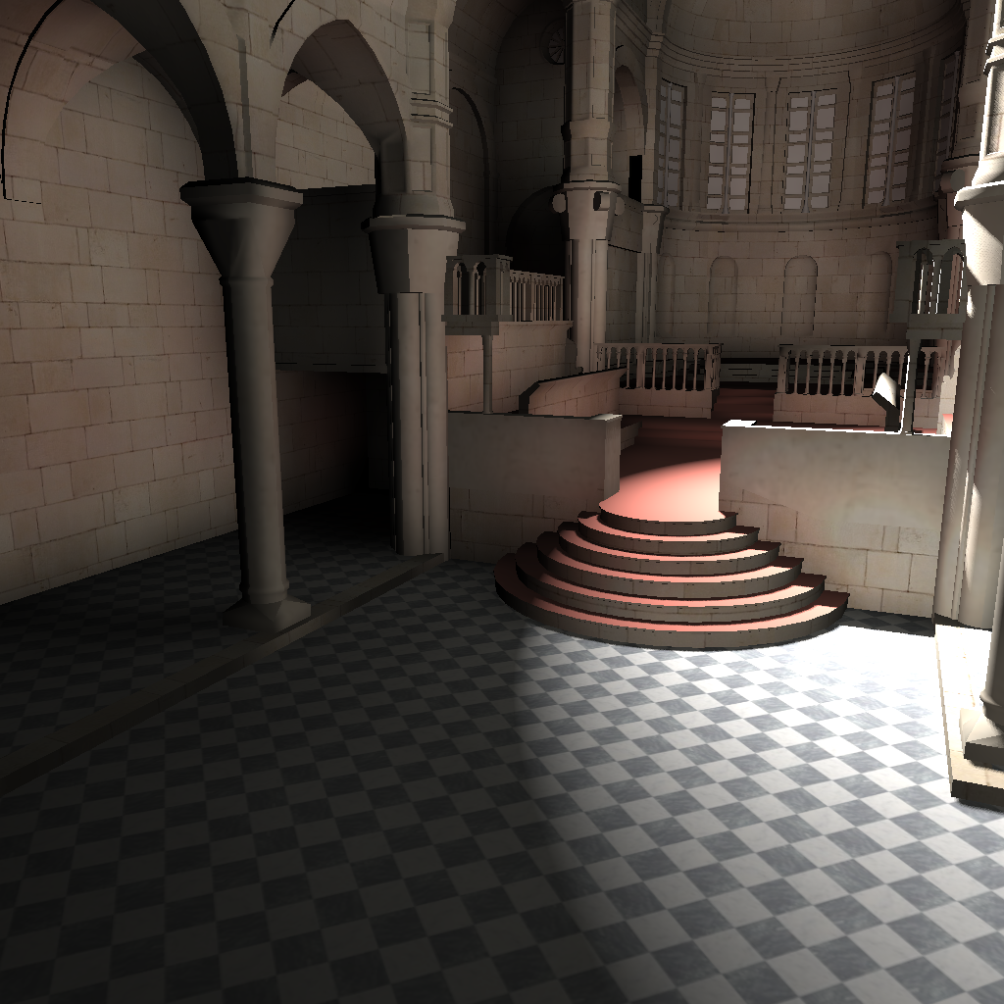
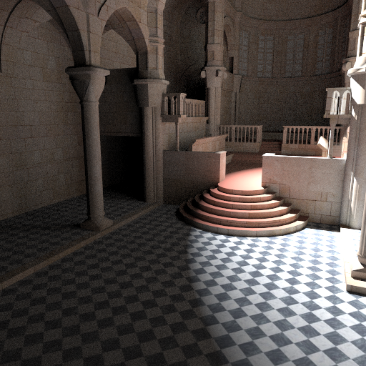
Ground Truth Comparison
Both 512 x 512
Ours: 77 ms
Path tracing: 137 min

Slide 30
Performance
On NVIDIA Geforce 260 GTX @ 1024 X 1024 with environment map @ 512 x 512 x 6
Scene | Triangles | Global Photons | Caustic Photons | FPS
Box1 | 15K | 376K | 0 | 11.4
Water | 21K | 91K | 89K | 12.8
Room1 | 84K | 403K | 2.9K | 5.4
Sibenik | 79K | 739K | 0 | 5.5
Box2 | 58K | 464K | 0 | 9.2
Room2 | 101K | 368K | 0 | 7.5
Ring | 2.1K | 0 | 164K | 28.2
Under Water | 54K | 536K | 822K | 6.3
Principle : High quality first

Slide 31
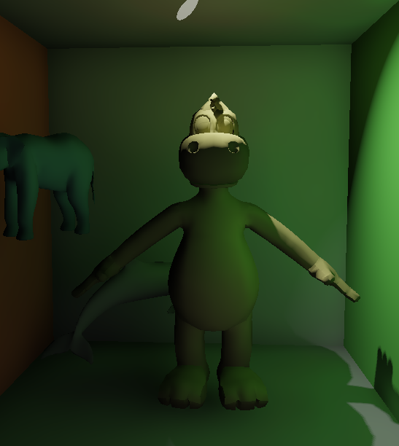
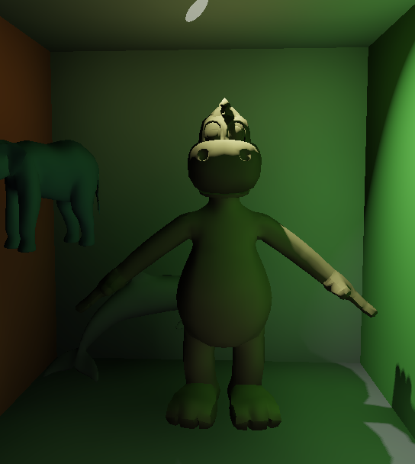
Performance/Quality
800 X 800
776k photons @ 11 FPS
78k photons @ 40 FPS
Similar to [McGuire 09]
Indirect shadow
Boundary bias

Slide 32
Limitation：Bias
Blurry shadow
Light leaking
Dark area
Ours: 77 ms
Path tracing: 137 min

Slide 33
Limitation: Reflection
Ours: 26 ms
Photon Mapping: 5 min

Slide 34
Video

Slide 35
Video

Slide 36
Conclusions
A new method for interactive global illumination based on photon mapping
Both steps are in image-space, entirely on GPU
No pre-computation
Easy implementation with shaders
Future improvement
Performance
Selective photon tracing
Quality
GPU final gathering
Notes:
In conclusion, here we present a new method for interactive global illumination based on photon mapping.
The two steps of photon mapping are both process in image-space, entirely on the GPU.
This method don’t need any pre-computations, and is simple for implmentation with shaders.

Slide 37
Thank you for your attention

